Slide 1

Workman
Group Members :
Name : Zahid Sher Khan
RegNo : 19MDSWE054
Name : Afaq Ahmad
RegNo : 19MDSWE071
Supervisor :
Engr Shaharyar

Slide 2
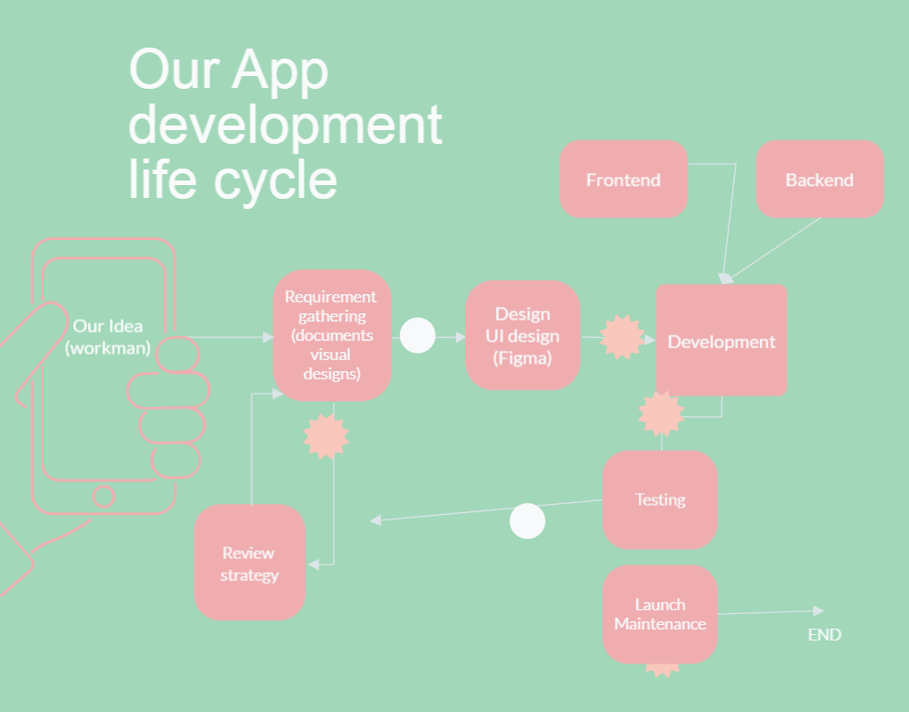
Workman

Slide 3
Activity (Nov-Jan) | Nov 17-24 | Nov 24-Dec 8 | Dec 15-22 | Dec 22-30 | Jan 1-7 | Jan 7-14
Changes in Proposal Printing of FYP record book | √
Preparation of SRS version 1 |  | √
SRS version 2 ERD Diagram |  |  | √
SRS version 3 ERD enhancement |  |  |  | √
Performing survey from labors Changes in SRS |  |  |  |  | √
Preparation and rehearsal for presentation |  |  |  |  |  | √

Slide 4
Workman
Our Achievement:
1. Making of SRS version 1
2. Making of SRS version 2
3. Making of SRS version 3
Enhanced ERD
Survey from three district about Workman
Changes in Proposal
Keeping record of every progress we make in printed record book
Meeting regularly with our supervisor

Slide 5
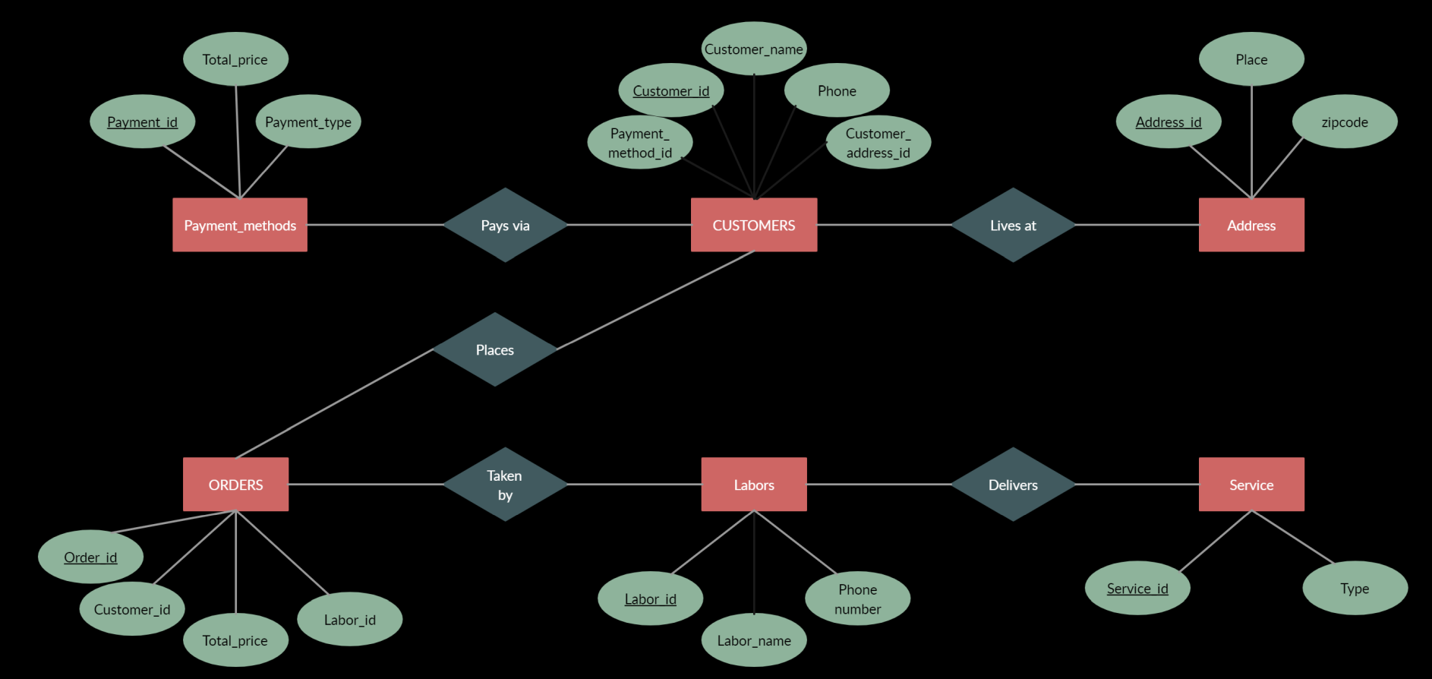
Workman
ERD 1

Slide 6
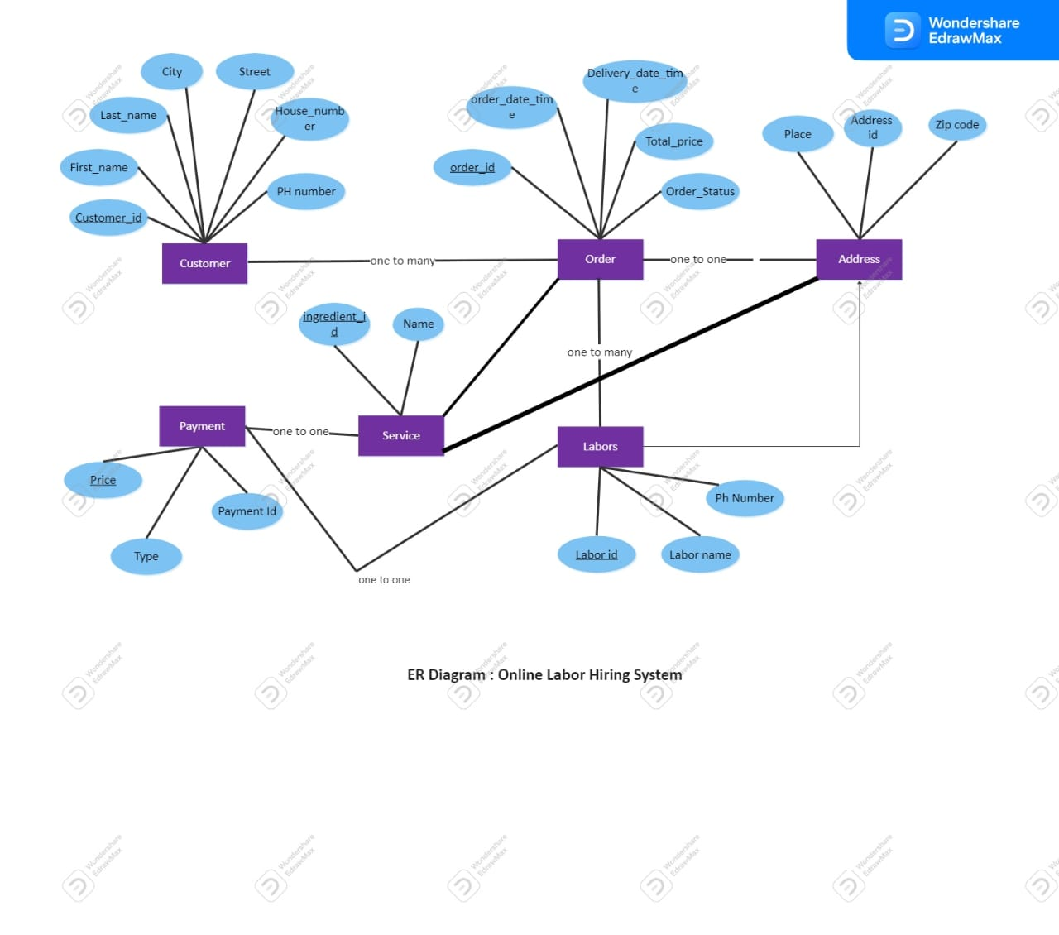
Workman
ERD 2

Slide 7
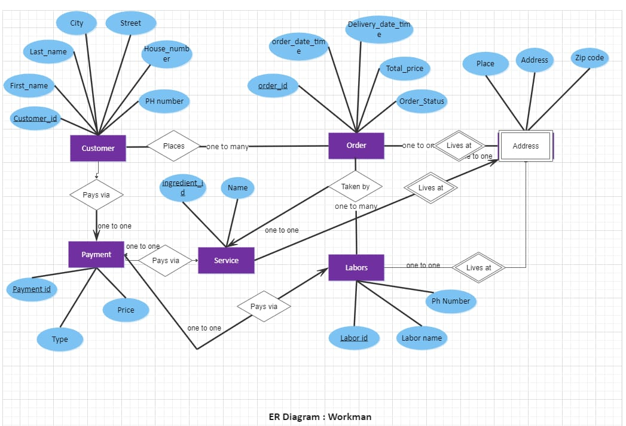
Workman
ERD 3

Slide 8
Workman
SRS version 1 link
https://docs.google.com/document/d/10Cx8yI9tdJ7Koh8qlfYRIhUoD_0WsJ_6/edit?usp=drivesdk&ouid=108502973143159453448&rtpof=true&sd=true
SRS version 2 link
https://docs.google.com/document/d/10DNy4hSgEyKNSxa2sxQUKGcnvTJqps4P/edit?usp=drivesdk&ouid=108502973143159453448&rtpof=true&sd=true
SRS version 3 link
https://docs.google.com/document/d/10BXpek_gnFHbjjx0AcKob_ADnlEXkdVr/edit?usp=drivesdk&ouid=108502973143159453448&rtpof=true&sd=true
Survey link
https://drive.google.com/file/d/1-uvYtJ9FUDFntY1bghriPXF3mIFC1ndw/view?usp=drivesdk

Slide 9


